Slide 1
Mellen School District
Financial Presentation January 2024

Slide 2
Budget Constraints
The District is facing a budget deficit due to inadequate state funding.
The state has not allowed a per-pupil adjustment aligned to inflation in the past 14 years.
Our mill rate is lower than our neighboring districts and the state average.
Despite a well managed budget and responsible spending, expenses continue to rise making it increasingly difficult to fund school operations.
Notes:
Inflation: increasing costs of employee benefits such as health insurance, utilities cost (natural gas prices), food for school meals, to name a few. In addition to all this, Special Education Funding: Wisconsin's rate of reimbursement of 30% is the lowest in the country.

Slide 3
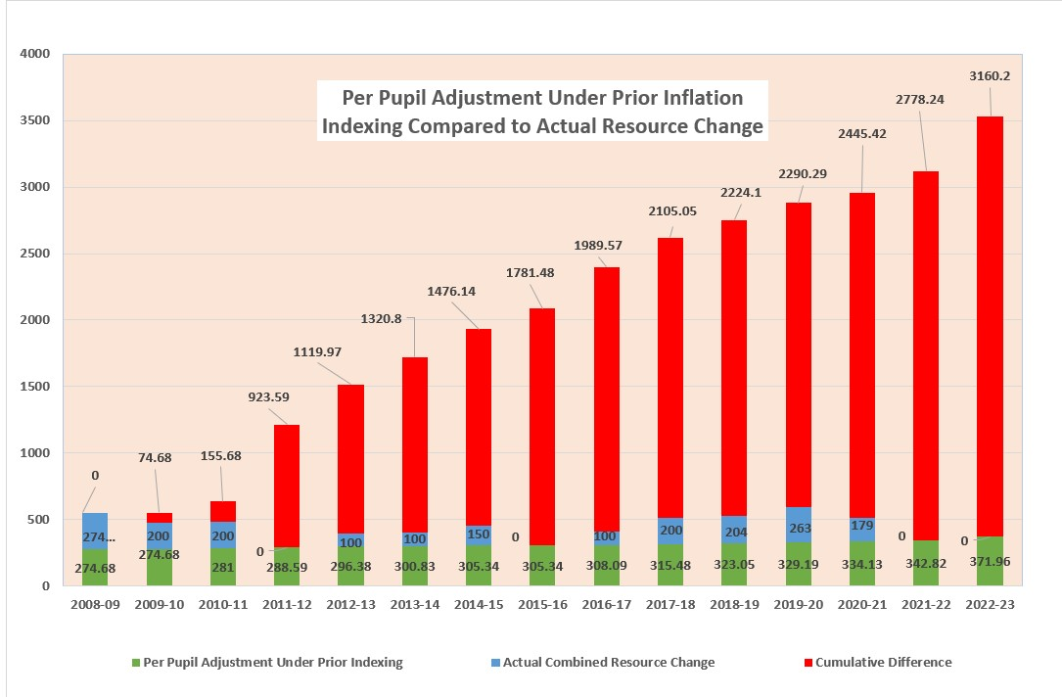
Per Pupil Adjust Actual Compared to PPA Under Prior Inflation
Notes:
The graph shows the ever increasing gap (red) between what is needed to fund school operations and what the state is providing. Since 2009 the State of Wisconsin has not provided an inflationary index to per pupil spending. The gap has grown to an amount of $3,160.20.

Slide 4
Budget Review
Fall 2022: Began 3 year projection
Winter 2022: Began future staffing proposal
Winter 2022: Presented budget projections
Spring 2023: Identified areas of reduction
Summer 2023: Completed facility needs assessment
Fall 2023: Reviewed all funding sources
Notes:
Given this information, back in 2022 the administration began reporting to the school board budget and programming reviews

Slide 5
Budget Review continued…
Fall 2023: Presented budget at annual meeting
Winter 2023: Presented multi-year projections and potential deficit scenarios to the Board
Winter 2023: Presented community survey results to the Board
Winter 2023: Referendum resolution presented for Board consideration
Spring 2024: Communication campaign to all stakeholders for April election
Notes:
The District has explored multi-year projections; one of which will be present shortly. As a reminder, projections are estimations made upon assumptions. A community survey was conducted prior to the referendum resolution presented to the board.

Slide 6
Programming Review
Reviewed programming based on the following factors: staffing and enrollment trends along with student outcomes
Reviewed programming in alignment with graduation requirements at the secondary level
Identified questions requiring further discussion and investigation
We have reviewed all academic, extracurricular, facilities and maintenance, transportation, staffing, purchased services, technology, food service, SpEd, equipment and supply programs
Notes:
The administration has reviewed all areas of current programming. The district has cut staff and other programming areas while continuing to provide the quality education that our children deserve.

Slide 7
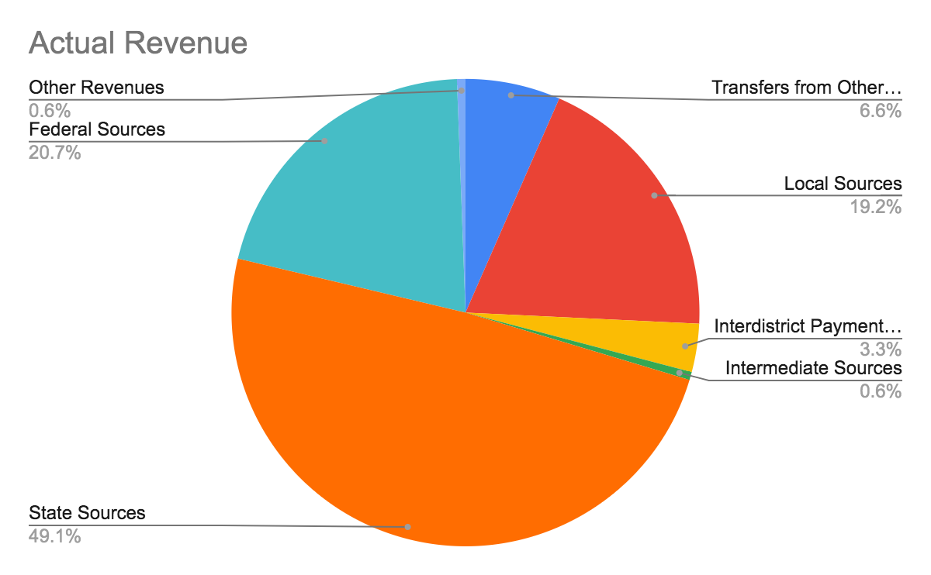
2022-23 Revenue Sources
Notes:
About 70% of our revenue comes from state and federal sources with less than 20% coming from local sources

Slide 8
2023-24 Revenue Summary
Notes:
The percentages are fairly similar from 22-23 to 23-24. However, in 24-25 the federal portion will shrink due to the end of ESSER funds.

Slide 9
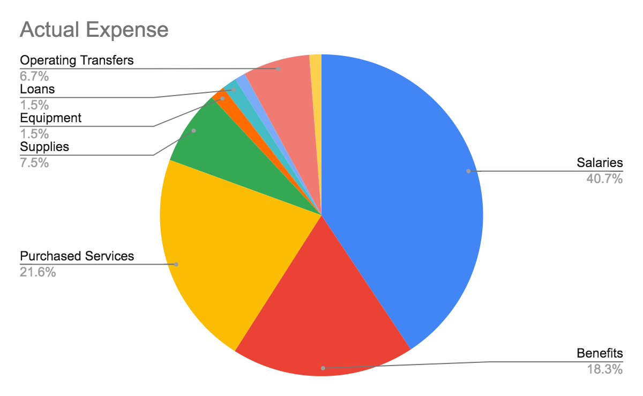
2022-23 Expense Summary
Notes:
Salaries and benefits make up approximately 59% of the overall budget. In the majority of school districts this is between 80-85% When you add on the purchased services part of which include CESA 12 shared services such as SpEd Director, OT, PT etc it brings the district to approximately 70% which is still below the 80-85% average. In fact, the District’s average teacher salary is the second lowest if the Districts in CESA 12.

Slide 10
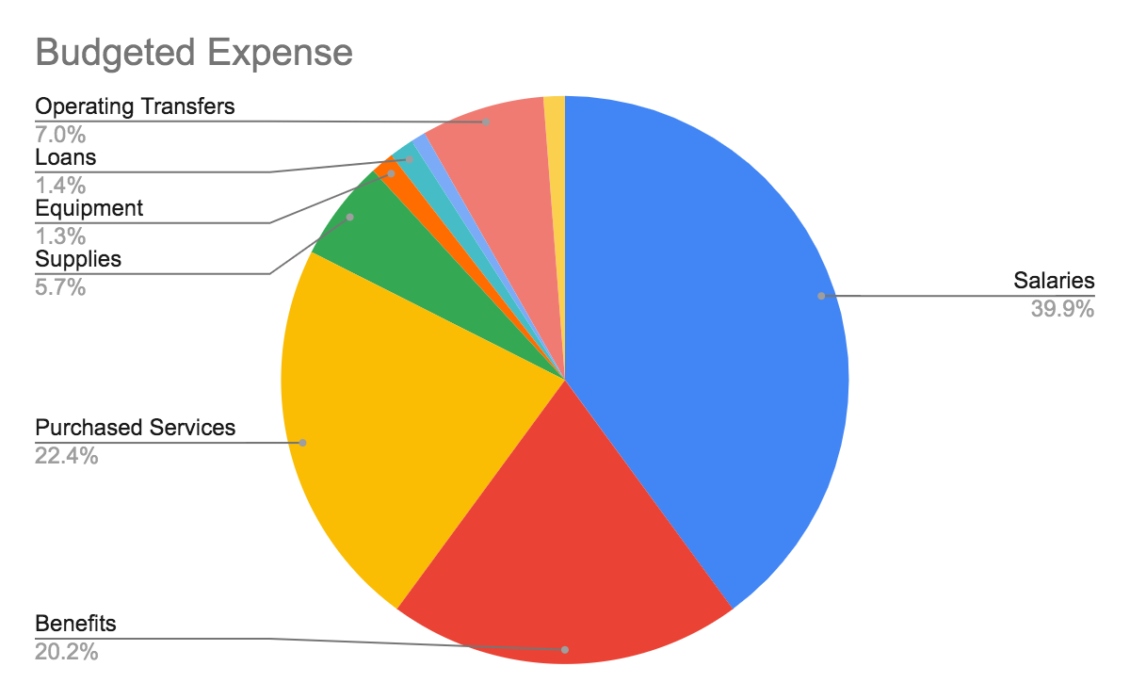
2023-24 Expense Summary
Notes:
Again, the percentages are very similar from 22-23 to 23-24.

Slide 11
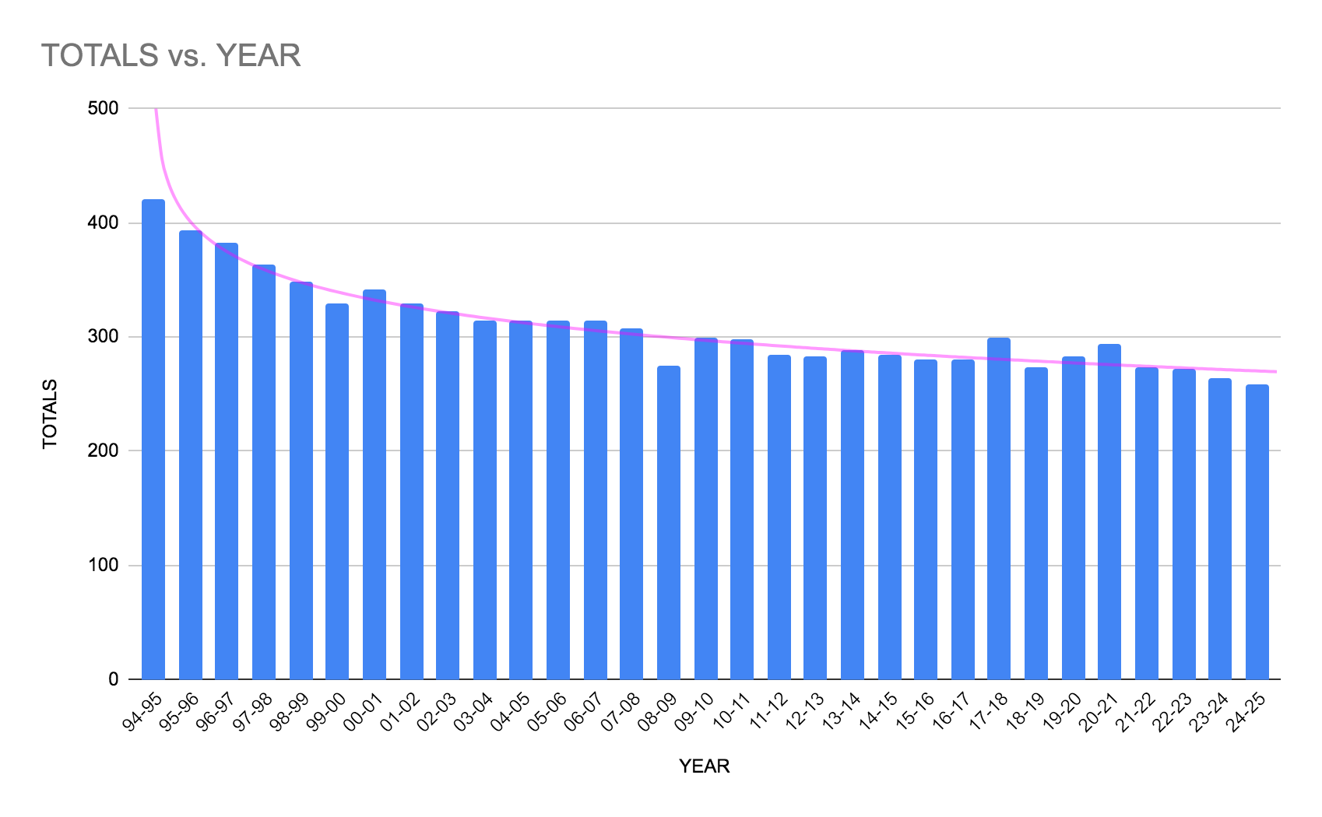
Enrollment Trend and Impact on State Aid
Notes:
Like many districts in Wisconsin, SDM has been experiencing declining enrollment. From approximately 420 in 1994-95 to 264 in 2023-24. That’s a decrease of approximately 156 students. Since Wisconsin provides per pupil aid, when enrollment decreases it directly impacts the amount of per pupil aid a district receives.

Slide 12
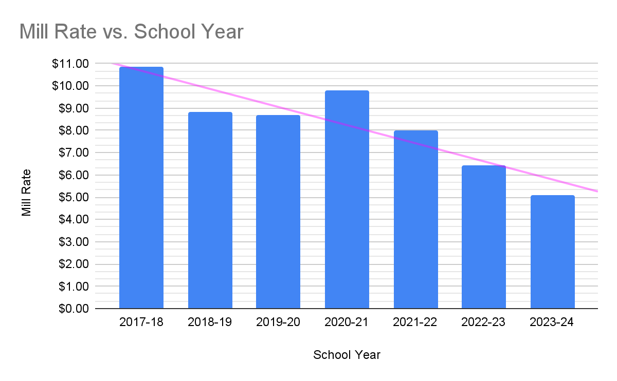
Mill Rate Trend
Notes:
The mill rate has continued to decrease as well from $10.84 in 2017-28 to $5.11 in 2023-24. Thereby decreasing the local funding provided to the district.

Slide 13
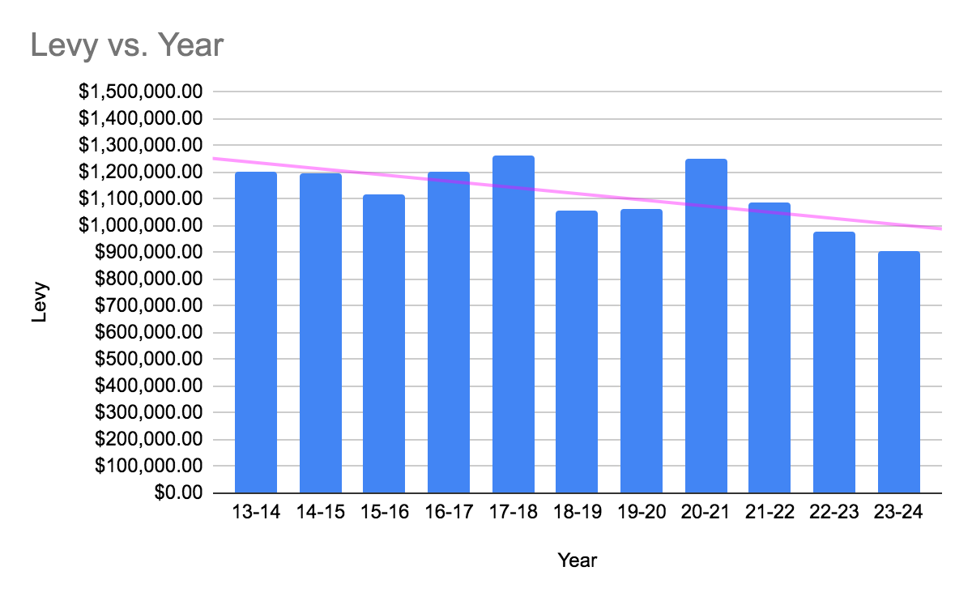
Tax Levy 10 year Trend
Notes:
As the mill rate decreases so does the tax levy; thereby reducing the amount of local aid the school receives

Slide 14
Funding Our Future - Current Conditions
Projected budget deficit 2023-24 - about $319,000
Projected budget deficit 2024-25 - about $236,048
Projected budget deficit 2025-26 - about $243,745
Projected budget deficit 2026-27 - about $330,535
Funded at a lower mill rate than our neighboring communities
Funded at a lower mill rate lower than the state average
Notes:
Again, these are projections based on assumptions regarding staffing and the costs of the various systems within a school districts operations.

Slide 15
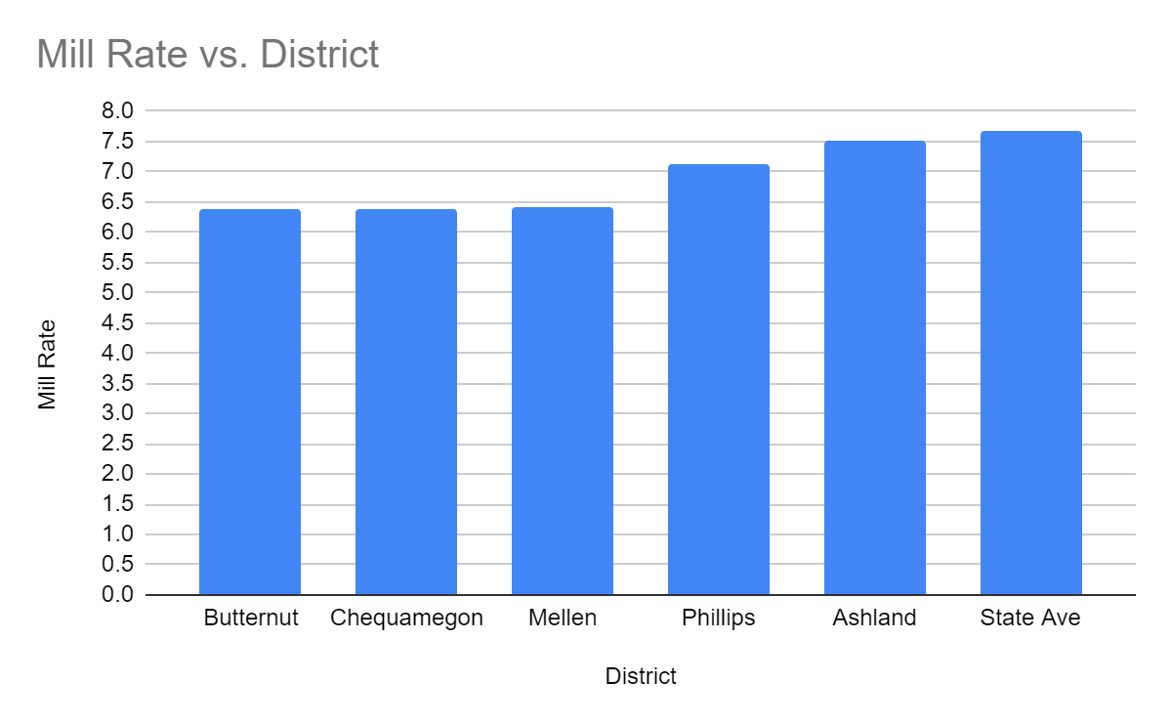
Mill Rate Comparison
Notes:
22-23 Mill rates
23-24 Mellen mill rate is $5.11

Slide 16
Funding Our Future - Referendum Conditions
Projected budget deficit 2023-24 - about $319,000
Projected budget surplus 2024-25 - about $209,476
Projected budget surplus 2025-26 - about $146,214
Projected budget surplus 2026-27 - about $2,747
Funded at a lower mill rate than 10 years ago
Notes:
Adequate funding is required to meet our immediate needs and avoid future budget deficits. Even with the operation referendum, the SDM remains at a lower mill rate than 10 years ago $10.36.

Slide 17
Immediate Needs
Attract and retain high-quality staff
Maintain current educational and extracurricular programming
Provide the needed reading and math interventions for students
Upgrade safety and security infrastructure
Enhance technology resources and support
Secure budget for facility maintenance
Notes:
A referendum is needed to secure funding for educational programs, services, and resources to deliver the highest quality education for each student.

Slide 18
Recommendation
Increase revenue limit authority:
$500,000 2023-24
$500,000 2024-25
$500,000 2025-26
Notes:
Propose a 3 year non-recurring $500,000 operational referendum to be on the ballot for 4/2/24

Slide 19
Tax Impact
Mill rate:
$2.46 per $1,000 per assessed property value
Annual $246 for a home valued at $100,000
Notes:
Fiscal Responsibility: Maintain mill rate lower than the state average and most neighboring district comparables.

Slide 20
Unmet Needs Covered by Grant Funds
STEM Innovation Grants:
used to purchase state-of-the-art lab equipment
technology equipment
digital literacy software
CNC Lathe, CNC Mill, Plasma Cutter, 3D printer, Vinyl Cutter, Laser Engraver
STEM courses, electrical supplies, and materials for student-led projects
Notes:
$1.6 Million over the past 5 years

Slide 21
Unmet Needs Continued…
School Safety Grants:
used to purchase security window film
two-way radios, video entry system and security cameras
safety training and first aid and trauma kits
dome mirrors and door lock replacements
front entrance remodel and main office updates
Notes:
$1.6 Million over the past 5 years

Slide 22
Unmet Needs Continued…
Food Service Grants:
FS equipment and supplies, expand menu options, additional FS staff during COVID
purchase fresh fruits and vegetables, mobile meals cart and composting equipment
supplies for physical activities
free breakfast, lunch, and afternoon snack for all students
Notes:
$1.6 Million over the past 5 years

Slide 23
Unmet Needs Continued
Academic and Career Planning:
used for ACP Scope and Sequence Support and to develop ACP/Pathways page on the school website
purchase of school vehicle for transporting students to workplace, transition training for staff, employment training for students
Notes:
$1.6 Million over the past 5 years

Slide 24
Unmet Needs Continued
Student Mental Health and Wellbeing:
Suicide Prevention Training, Yellow Tulip Project
Telecounseling services, Blue Room supplies
Executive Functioning curriculum, Mental Health Literacy training and curriculum
Trauma Sensitive Practices training
Positive messaging, increase School and Community access to mental health services
Neurosequential training and supplies, telenursing services, airway clearance device to prevent choking,
4 portable AEDs for athletics
Notes:
$1.6 Million over the past 5 years

Slide 25
Unmet Needs Continued…
Facilities Improvement Grant:
Expand outdoor learning opportunities
2 water bottle filling stations, water bottles and toothbrushes for all students
Notes:
$1.6 Million over the past 5 years

Slide 26
Unmet Needs Continued…
Arts and Culture Enrichment Grant:
used to bring in artists for workshops and organize cultural events
invest in art supplies and equipment
Notes:
$1.6 Million over the past 5 years

Slide 27
Unmet Needs Continued
Community Outreach and Service Learning Grant:
used to purchase supplies and equipment for the Digger Center, the MS/HS after school program, the Ski program, staffing for both programs
Family Room
Technology
School garden
Family engagement support
Notes:
$1.6 Million over the past 5 years

Slide 28
Unmet Needs Continued…
Teacher initiated Donors Choose Grants:
Two tables
Cushions, chair, and wobble stools
Rug
2 wobble stools
Magnet tiles, picasso tiles, and storage bins
Chairs
Notes:
$1.6 Million over the past 5 years

Slide 29
Unmet Needs Continued…
Teacher initiated Donors Choose Grants:
Flexible seating chairs
Large iPad for student use
Digital art class for digital tools
STEM Tools
Notes:
$1.6 Million over the past 5 years

Slide 30
Unmet Needs Continued…
Teacher initiated Donors Choose Grants:
Classroom organization items
Teachers Pay Teachers gift cards (2)
Books for classroom library
Floor table & flexible seating
ELA materials for project based learning
Notes:
$1.6 Million over the past 5 years

Slide 31
In Summary
Increase revenue limit authority by $500,000 per year for three years
Mill rate: $2.46 per $1,000 per assessed property value

Slide 32
Baird Forecast Model
The forecast model provides tools for short and long term financial planning by utilizing analyzing revenue limits, equalization aid, fund balance, and cash flow. The projections are based on tax levy and mill rate, salary and benefit costs and student enrollment to name a few.
Kim Zabel will provide a brief overview of the forecast model reviewed by the board in December 2023.

Slide 33
Questions

